Slide 1
NNM Computation in MATLAB
M. Peeters, L. Renson, G. Kerschen
October 2011

Slide 2
Useful preliminary reading
About NNMs:
Kerschen et al., Nonlinear normal modes, Part I: A useful framework for the structural dynamicist, Mechanical Systems and Signal Processing 23 (2009), 170-194.
About the algorithm:
Peeters et al., Nonlinear normal modes, Part II: Toward a practical computation using numerical continuation, Mechanical Systems and Signal Processing 23 (2009), 195-216.

Slide 3

MATLAB code sources
“NNMcont” directory:
Add this folder to the Matlab path
“NNMsources” Matlab source functions of the algorithm for NNM computation
“CLASS_NL” Different Matlab classes for defining nonlinearities
“Newmark” Matlab source functions for numerical time integration using Newmark method

Slide 4
MATLAB code sources
“NNMsources” directory:
“NNMcontinuation_... .p” Sources of the computation algorithm combining shooting and continuation methods
“NNMcont.p” Graphical user interface (GUI) to launch and control the computation

Slide 5
Running MATLAB code
In the working directory, create two user m-files:
“defsys.m” function Defining the dynamical system to study
“paramdisp.m” script Setting the result display properties
Type “NNMcont” in the Matlab command window to start the GUI for NNM computation. The system defined by the “defsys.m” file is then automatically loaded.

Slide 6
System definition: defsys.m file
The system of interest is described in the “defsys.m” function by defining the sys struct array with the specified fields:
sys.Klin and sys.Mlin fields (array nxn) stiffness and mass matrices of the underlying linear system
sys.nl filed (nonlinear object) object of nonlinear class defining the nonlinearities present in the system
Different optional fields sys.norm, sys.IGcont, sys.vitfix

Slide 7
System definition: defsys.m file
function sys = defsys()
sys.Klin= …
sys.Mlin= …
sys.nl= …
…
Field | Description
sys.Klin | Stiffness matrix (ndof x ndof) of the linear system
sys.Mlin | Mass matrix (ndof x ndof) of the linear system
sys.nl | Nonlinear class object defining the nonlinear terms of the system. This object is defined by means of the class constructor function (see below).
sys.norm | Norm of the linear mode used as initial guess for determining a first NNM motion at low energy (if the result MAT-file does not exist) [OPTIONAL]
sys.IGcont | Use of another initial guess for continuation specified by: sys.IGcont.x0 (vector of initial displacements, velocities being assumed to be equal to 0) and sys.IGcont.w (pulsation of the initial guess) [OPTIONAL]
sys.vitfix | Indexes of the velocities to set to zero as phase condition [OPTIONAL]

Slide 8

System definition: defsys.m file
Duffing example:
$$\ddot{m}y+ky+k_{nl}y^{3}=0$$
function sys = defsys()
m=…;k=…;knl=…;
sys.Klin= [k];
sys.Mlin= [m];
coeffnl=knl;expnl=3;
nl_law=NL_LAW_POLY(coeffnl,expnl);
pos1=0;pos2=1;
sys.nl= NL_SPRING(pos1,pos2,nl_law);

Slide 9

System definition: defsys.m file
2DOF example:
$$\left[\begin{matrix}m1 & 0 \\ 0 & m2\end{matrix}\right]\left\{\begin{matrix}\ddot{x1} \\ \ddot{x2}\end{matrix}\right\}+\left[\begin{matrix}k1 & k12 \\ k12 & k2\end{matrix}\right]\left\{\begin{matrix}x1 \\ x2\end{matrix}\right\}+\left\{\begin{matrix}knl1{.x1}^{3}+knl12{(x1−x2)}^{3} \\ knl2{.x2}^{3}+knl12{(x2−x1)}^{3}\end{matrix}\right\}=\left\{\begin{matrix}0 \\ 0\end{matrix}\right\}$$
function sys = defsys()
m1=…;m2=…;k1=…;k2=…;k12=…;knl1=…;knl2=…;knl12=…;
sys.Klin= [k1 k12;k12 k2];
sys.Mlin= diag([m1 m2]);
coeffnl=knl1;expnl=3;nl_law=NL_LAW_POLY(coeffnl,expnl);
pos1=1;pos2=0;
sys.nl(1)= NL_SPRING(pos1,pos2,nl_law);
coeffnl=knl2;expnl=3;nl_law=NL_LAW_POLY(coeffnl,expnl);
pos1=2;pos2=0;
sys.nl(2)= NL_SPRING(pos1,pos2,nl_law);
coeffnl=knl12;expnl=3;nl_law=NL_LAW_POLY(coeffnl,expnl);
pos1=1;pos2=2;
sys.nl(3)= NL_SPRING(pos1,pos2,nl_law);

Slide 10
Nonlinear object class
Nonlinear class = nonlinear element defined in “CLASS_NL” directory:
Oriented object style of Matlab
Each class corresponds to a type of nonlinearity
More general formulation
Easy implementation of other kinds of nonlinearities by developing a new nonlinear class (in a specified directory)

Slide 11
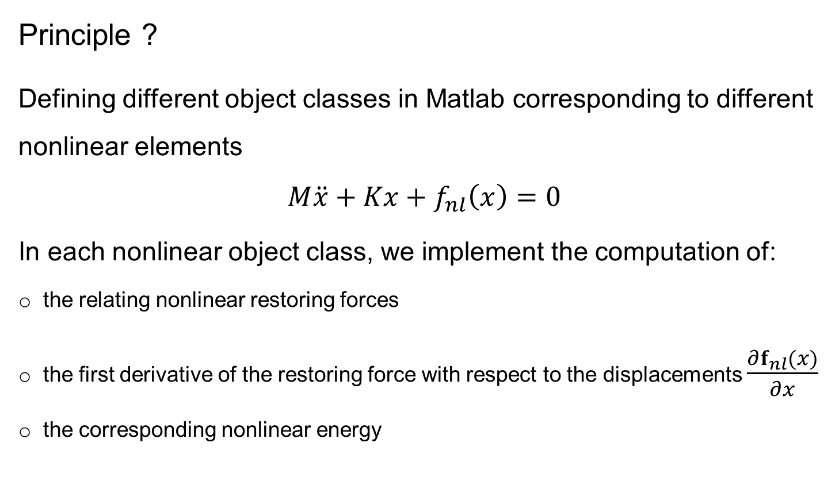
Nonlinear object class
Principle ?
Defining different object classes in Matlab corresponding to different nonlinear elements
$$M\ddot{x}+Kx+f_{nl}\left(x\right)=0$$
In each nonlinear object class, we implement the computation of:
the relating nonlinear restoring forces
the first derivative of the restoring force with respect to the displacements $\frac{∂f_{nl}(x)}{∂x}$
the corresponding nonlinear energy

Slide 12
Nonlinear object class
In Matlab, each class is defined in a directory with the @ symbol. The name of the directory is the name of the class.
A class is then described by:
a constructor function >> help NAME_CLASS
several methods functions >> methods NAME_CLASS

Slide 13
Nonlinear object class
Existing classes for defining nonlinear laws (in CLASS_NL\NL_LAW directory):
@NL_LAW_POLY polynomial law
@NL_LAW_LINPIECEWISE piecewise law
@NL_LAW_UNILAT unilateral law
nl_law_poly.m
f_nl.m, df_nl.m, Energy_nl.m
nl_law_linpiecewise.m
f_nl.m, df_nl.m, Energy_nl.m
nl_law_unilat.m
f_nl.m, df_nl.m, Energy_nl.m
Notes:
Constructor and common method functions

Slide 14
Nonlinear object class
NL_LAW_POLY illustration:
>> help NL_LAW_POLY
Constructor of polynomial nonlinear law objects (NL_LAW_POLY class)
[nlobj] = NL_LAW_POLY(coeffnl,expnl)
- coeffnl: coefficient of the polynomial law
- expnl: exponent of the polynomial law
f(x)=coeffnl*x^(expnl)
>> methods NL_LAW_POLY
Methods for class NL_LAW_POLY:
Energy_nl NL_LAW_POLY df_nl f_nl
>> help NL_LAW_POLY.f_nl
Computation of the nonlinear function relating to NL_LAW_POLY
object:
[f_nl] = f_nl(obj,x)
- obj: NL_LAW_POLY object
- x: function argument

Slide 15
Nonlinear object class
NL_LAW_POLY illustration:
Cubic law example:
>> obj_nl_law = NL_LAW_POLY(1,3);
>> f_nl(obj_nl_law,1)
ans =
1
>> f_nl(obj_nl_law,2)
ans =
8

Slide 16
Nonlinear object class
Nonlinear law object illustration
example_nl_law.m file:
clear all;
% quadratic law
obj1=NL_LAW_POLY(1,2);
% cubic
obj2=NL_LAW_POLY(1,3);
% unilateral law (e.g., Hertz contact)
obj3=NL_LAW_POLY(1,3/2);
obj3=NL_LAW_UNILAT(obj3);
% linear piecewise law
obj4=NL_LAW_LINPIECEWISE(1,10,1.5);

Slide 17
Nonlinear object class
Nonlinear law object illustration
example_nl_law.m file
x=[-3:0.1:3];
f=zeros(length(x));
df=zeros(length(x));
k=1;
for y=x
f1(k)=f_nl(obj1,y);df1(k)=df_nl(obj1,y);
f2(k)=f_nl(obj2,y);df2(k)=df_nl(obj2,y);
f3(k)=f_nl(obj3,y);df3(k)=df_nl(obj3,y);
f4(k)=f_nl(obj4,y);df4(k)=df_nl(obj4,y);
k=k+1;
end
figure
plot(x,f1,'.r-',x,f2,'ob-',x,f3,'sk-',x,f4,'+g-')
figure
plot(x,df1,'.r-',x,df2,'ob-',x,df3,'sk-',x,df4,'+g-')

Slide 18
Nonlinear object class
Nonlinear law object illustration
example_nl_law.m file

Slide 19
Nonlinear object class
Existing classes of structural nonlinearties (in CLASS_NL\NL_ELEMENT directory):
@NL_SPRING nonlinear spring
@NL_USER nonlinearities directly defined by the user
with the common methods functions:
fint_nl.m nonlinear internal force vector
dfint_nl.m first derivative of internal forces
Energy_nl.m energy relating to the nonlinear element

Slide 20
Nonlinear object class: NL_SPRING
NL_SPRING element
Constructor (see “help NL_SPRING”):
obj_nl=NL_SPRING(pos1,pos2,nl_law)
pos1 = DDL1
pos2 = DDL2
nl_law = object defining the nonlinear law of the spring (e.g., NL_POLY_LAW class object)

Slide 21
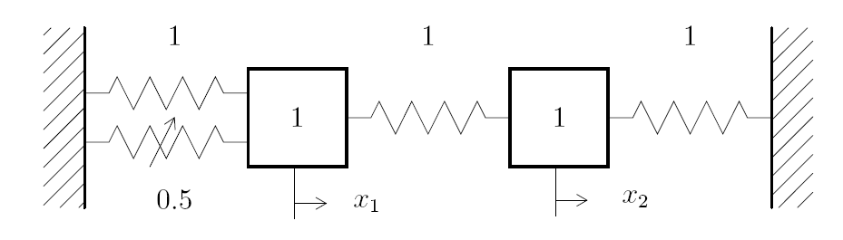

Nonlinear object class: NL_SPRING
Duffing example:
$$\ddot{m}y+ky+k_{nl}y^{3}=0$$
function sys = defsys()
m=…;k=…;knl=…;
sys.Klin= [k];
sys.Mlin= [m];
coeffnl=knl;expnl=3;
nl_law=NL_LAW_POLY(coeffnl,expnl);
pos1=1;pos2=0;
sys.nl= NL_SPRING(pos1,pos2,nl_law);

Slide 22

Nonlinear object class: NL_SPRING
2DOF example:
$$\left[\begin{matrix}m1 & 0 \\ 0 & m2\end{matrix}\right]\left\{\begin{matrix}\ddot{x1} \\ \ddot{x2}\end{matrix}\right\}+\left[\begin{matrix}k1 & k12 \\ k12 & k2\end{matrix}\right]\left\{\begin{matrix}x1 \\ x2\end{matrix}\right\}+\left\{\begin{matrix}knl1{.x1}^{3}+knl12{(x1−x2)}^{3} \\ knl2{.x2}^{3}+knl12{(x2−x1)}^{3}\end{matrix}\right\}=\left\{\begin{matrix}0 \\ 0\end{matrix}\right\}$$
function sys = defsys()
m1=…;m2=…;k1=…;k2=…;k12=…;knl1=…;knl2=…;knl12=…;
sys.Klin= [k1 k12;k12 k2];
sys.Mlin= diag([m1 m2]);
coeffnl=knl1;expnl=3;nl_law=NL_LAW_POLY(coeffnl,expnl);
pos1=0;pos2=1;
sys.nl(1)= NL_SPRING(pos1,pos2,nl_law);
coeffnl=knl2;expnl=3;nl_law=NL_LAW_POLY(coeffnl,expnl);
pos1=2;pos2=0;
sys.nl(2)= NL_SPRING(pos1,pos2,nl_law);
coeffnl=knl12;expnl=3;nl_law=NL_LAW_POLY(coeffnl,expnl);
pos1=1;pos2=2;
sys.nl(3)= NL_SPRING(pos1,pos2,nl_law);

Slide 23
Nonlinear object class: NL_USER
2) NL_USER element
Nonlinear terms specified by the functions
fint_nl_user.m
dfint_nl_user.m
Energy_nl_user.m
in the working directory.
Constructor (see “help NL_USER”):
obj_nl=NL_USER()

Slide 24

Nonlinear object class: NL_USER
2DOF example using NL_USER class
$$\left[\begin{matrix}m1 & 0 \\ 0 & m2\end{matrix}\right]\left\{\begin{matrix}\ddot{x1} \\ \ddot{x2}\end{matrix}\right\}+\left[\begin{matrix}k1 & k12 \\ k12 & k2\end{matrix}\right]\left\{\begin{matrix}x1 \\ x2\end{matrix}\right\}+\left\{\begin{matrix}knl1{.x1}^{3}+knl12{(x1−x2)}^{3} \\ knl2{.x2}^{3}+knl12{(x2−x1)}^{3}\end{matrix}\right\}=\left\{\begin{matrix}0 \\ 0\end{matrix}\right\}$$
with fint_nl_user.m, dfint_nl_user.m, Energy_nl_user.m
function sys = defsys()
m1=…;m2=…;k1=…;k2=…;k12=…;
sys.Klin= [k1 k12;k12 k2];
sys.Mlin= diag([m1 m2]);
sys.nl= NL_USER();

Slide 25
GUI for NNM computation
To launch the GUI for NNM computation:
>> NNMcont
Notes:
Insérer capture GUI (annoter FEP, computation parameters)

Slide 26
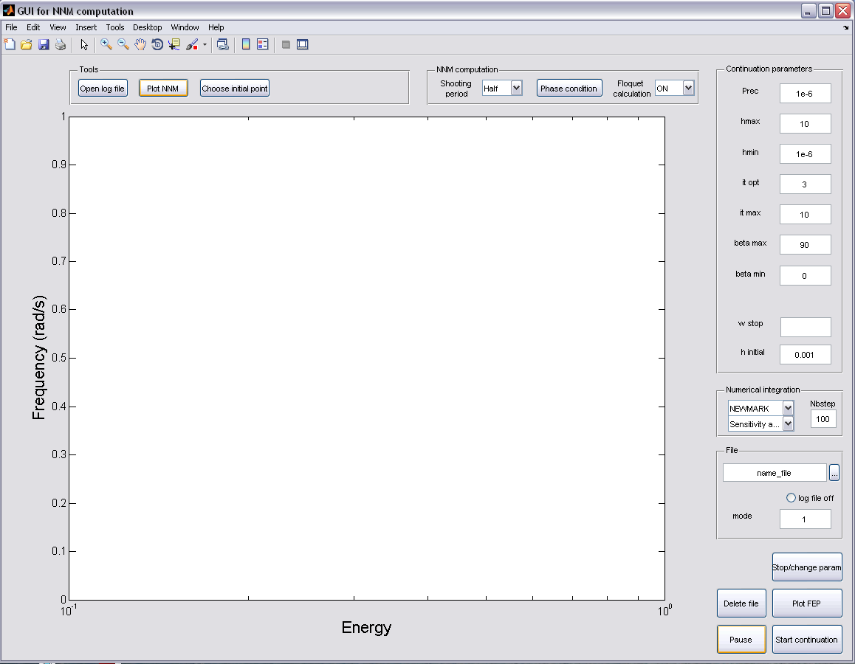
GUI for NNM computation
NNM computation parameters
Continuation
parameters
Frequency-Energy Plot
Numerical
integration
parameters
File
parameters
Notes:
Insérer capture GUI (annoter FEP, computation parameters)

Slide 27
GUI: NNM computation parameters
Time period of the shooting:
Half period (symetric motions)
Full period
Phase condition:
Selection of the velocity to set to zero
Calculation of Floquet multipliers during the computation (ON / OFF)

Slide 28
GUI: Continuation parameters
Relative precision (residue) of the shooting
Maximum continuation stepsize
Optimal number of iterations for stepsize control
Maximum number of iteration
Maximum angle (deg) to avoid branch switching
Minumum angle (deg) for stepsize control
Initial continuation stepsize

Slide 29
GUI: Numerical integration parameters
Scheme for numerical time integration:
Newmark
Runge-Kutta (ode45)
Number of time steps along one shooting period
Jacobian computation:
Sensitivity analysis
Finite differences

Slide 30
GUI: File parameters
Name of the
result MAT-file
Load a existing result MAT-file
Mode number to compute (NNM extension of this linear mode)

Slide 31
GUI: Starting computation
Interrupt the computation to change parameters
Start the computation:
If the result MAT-file does not exist, the algorithm uses the linear mode as initial guess for starting the continuation procedure (or the sys.IGcont field defined in the defsys.m file).
If the result MAT-file exists, the continuation is restarted from the last computed point.

Slide 32
Computation process and results
The computed NNM is represented in the FEP of the GUI.
Convergence information is displayed in the Matlab command window
The computed results are saved in the MAT-file with the following variables:
Pulsation: vector containing the pulsation (rad/s) of the computed NNM motions
Energy: vector containing the conserved total enegy of the computed NNM motions
Sol: matrix composed of the initial states (displacements and velocities) inducing the different computed NNM motions
Floq: vector containing the Floquet multipliers of the computed NNM motions

Slide 33

Result display in GUI
In the FEP of the GUI, right click:
Frequency in rad/s or Hz in the FEP
Representation of unstable motions (using red markers)

Slide 34
Result display in GUI
Display of computed NNM motions:
Choose one computed point in the FEP
The NNM motion is computed
Some results are plotted by default (time series, Floquet multipliers…)
Next, the user script paramdisp.m (in the working directory) is called
➔ You can configure the display by editing this file

Slide 35
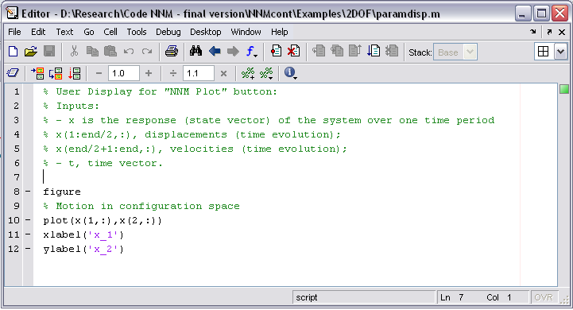
Result display in GUI

Slide 36
Illustrations
2DOF example (MSSP papers)
Directory “Examples\2DOF”

Slide 37
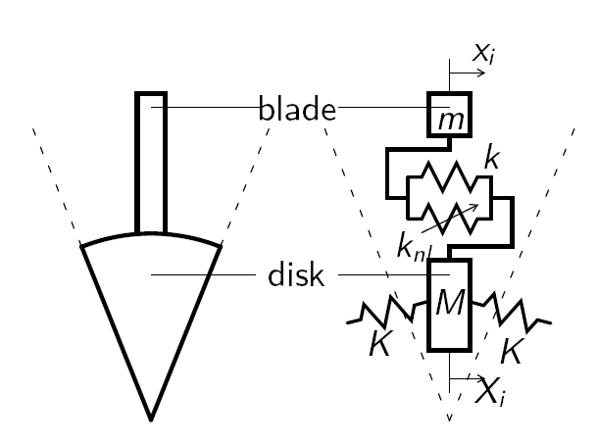
Illustrations
Simplified bladed disk (AIAA paper)
Directory “Examples\BladedDisk”
Simplified discrete model of bladed disk assembly (30 sectors)

Slide 38
References
Georgiades et al., Modal analysis of a nonlinear periodic structure with cyclic symmetry, AIAA Journal 47 (2009), 1014-1025.
Kerschen et al., Nonlinear normal modes, Part I: A useful framework for the structural dynamicist, Mechanical Systems and Signal Processing 23 (2009), 170-194.
Peeters et al., Nonlinear normal modes, Part II: Toward a practical computation using numerical continuation, Mechanical Systems and Signal Processing 23 (2009), 195-216.

